Slide 1



Presentation On PCB Design Layout
ESE 4009
Submitted To: Prof. Mike Aleshams
Submitted By: Sukhwinder Kaur (c0777211)
Group 4

Slide 2

Project Introduction
The main focus of this project is to distinguish the fall of elderly folk's individuals and report something like their relatives or care focuses. With the goal that the old ones can get satisfactory consideration opportune.
So, we will make a PCB on which number of components get soldered to detect the fall and send the information to the family members.

Slide 3
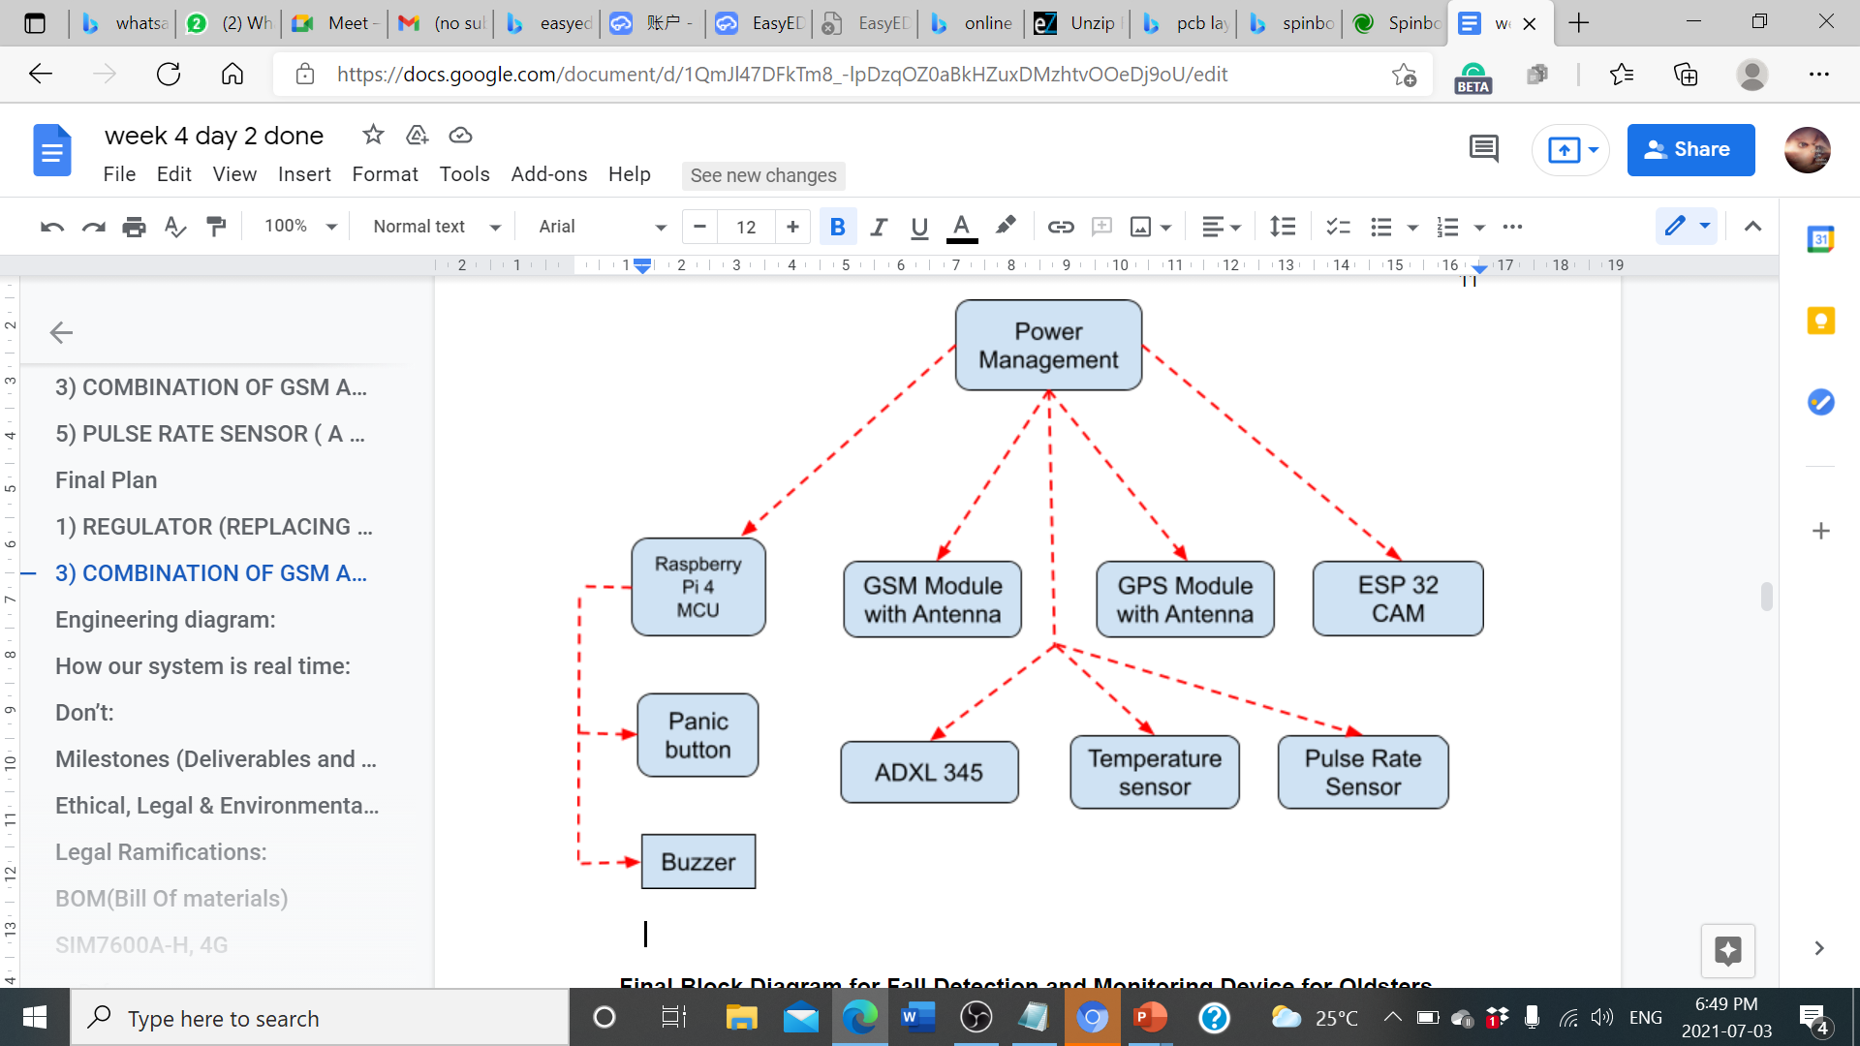
BLOCK Diagram of fall detection system

Slide 4
Table of content
What is PCB?
Types of Assembly Process
Why we use PCB?
How to Design PCB
Schematic Design of PCB
PCB Layout Design
Ordering the PCB

Slide 5
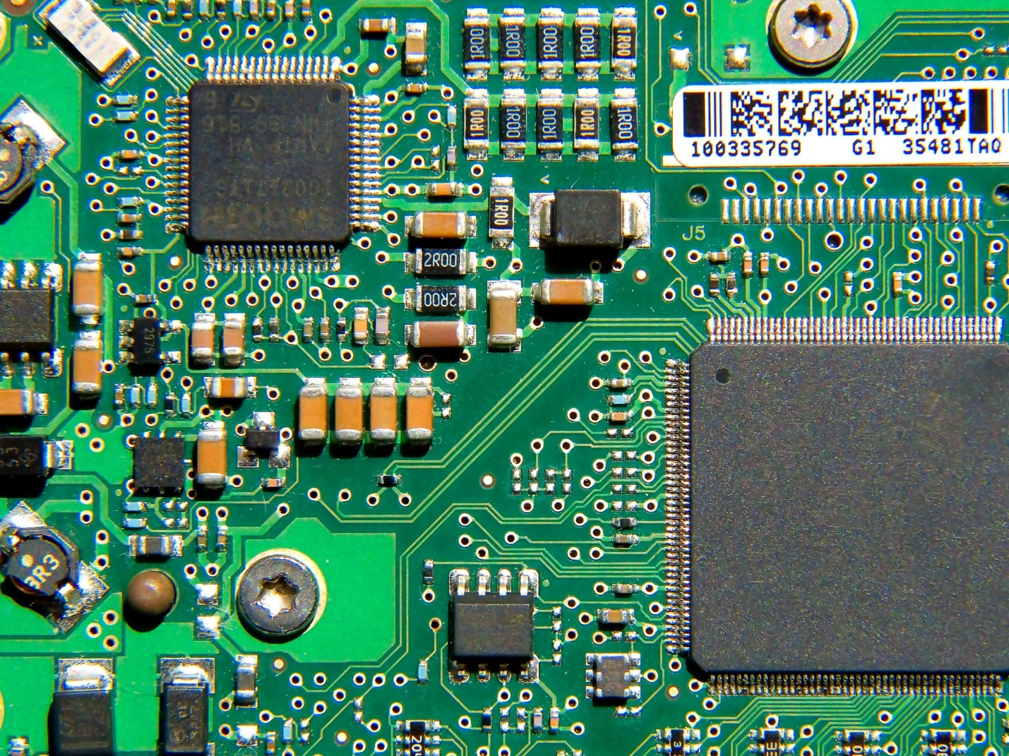
WHAT IS PCB?
Stands for "Printed Circuit Board.“
thin board made of fiberglass, composite epoxy, or other laminate material.
different components soldered on the PCB, such as transistors, resistors, and integrated circuits.
can be single-sided, double-sided or multilayer.

Slide 6
Types of Assembly Process
Thru-Hole Mounting
In the thru-hole mounting process, the assembler places component leads into holes drilled into a bare PCB.
Thru-hole technology creates a stronger connection than surface mount technology does, so it’s used for applications that require high reliability.
Thru-hole technology is also useful for testing and prototyping applications that require manual adjustments of components.

Slide 7
Types of Assembly Process
Surface Mounting
In the surface mounting process, components are mounted directly to the PCB surface using solder.
Using surface mounting allows the assembler to attach components to both sides of the board.
mounted components can also be smaller, enabling more parts to fit on a single board.
Surface mounting can also be completed faster and is a less involved process than thru-hole mounting is, further reducing costs.

Slide 8
Why we USE PCB?
PCBs are often associated with computers, they are used in many other electronic devices
serve as the foundation for electronic decices, such as video module, network interfacing modules, controlling miodules, etc.

Slide 9
How to design PCB Layout.
To design a PCB, first create a Schematic diagram of the Circuit
Schematic serves as a blueprint for laying out the traces and placing the components on the PCB.
the PCB editing software can import all of the components, footprints, and wires into the PCB file, which will make the design process easier.

Slide 10
Software and its features
project folder: shows all the created projects.
Design manager: information about all the placed components and wiring details.
Easyeda library (EELib): can find all the general components like gnd, Vcc, resistor, capacitor, diode, led etc.
General library: can find all the remaining component from LCSC and user contribution. It shows the component symbol, its footprint and its real image.

Slide 11
Software menu
File menu: we can create new schematic, PCB design etc. Also can open the circuit using other software's like kicad, Orcad etc.
Location menu: we can find all the components, wiring pins etc. and place on the circuit.
PCB menu: after creating the schematic, we can convert it to PCB. Anew window will open where we can design the new PCB.
Setting menu: for some general settings and simulation process.
Export BOM menu: can export all the list of components which we have used with their model number and purchasing list.
Appearance menu: we can change the theme and background of workplace.

Slide 12
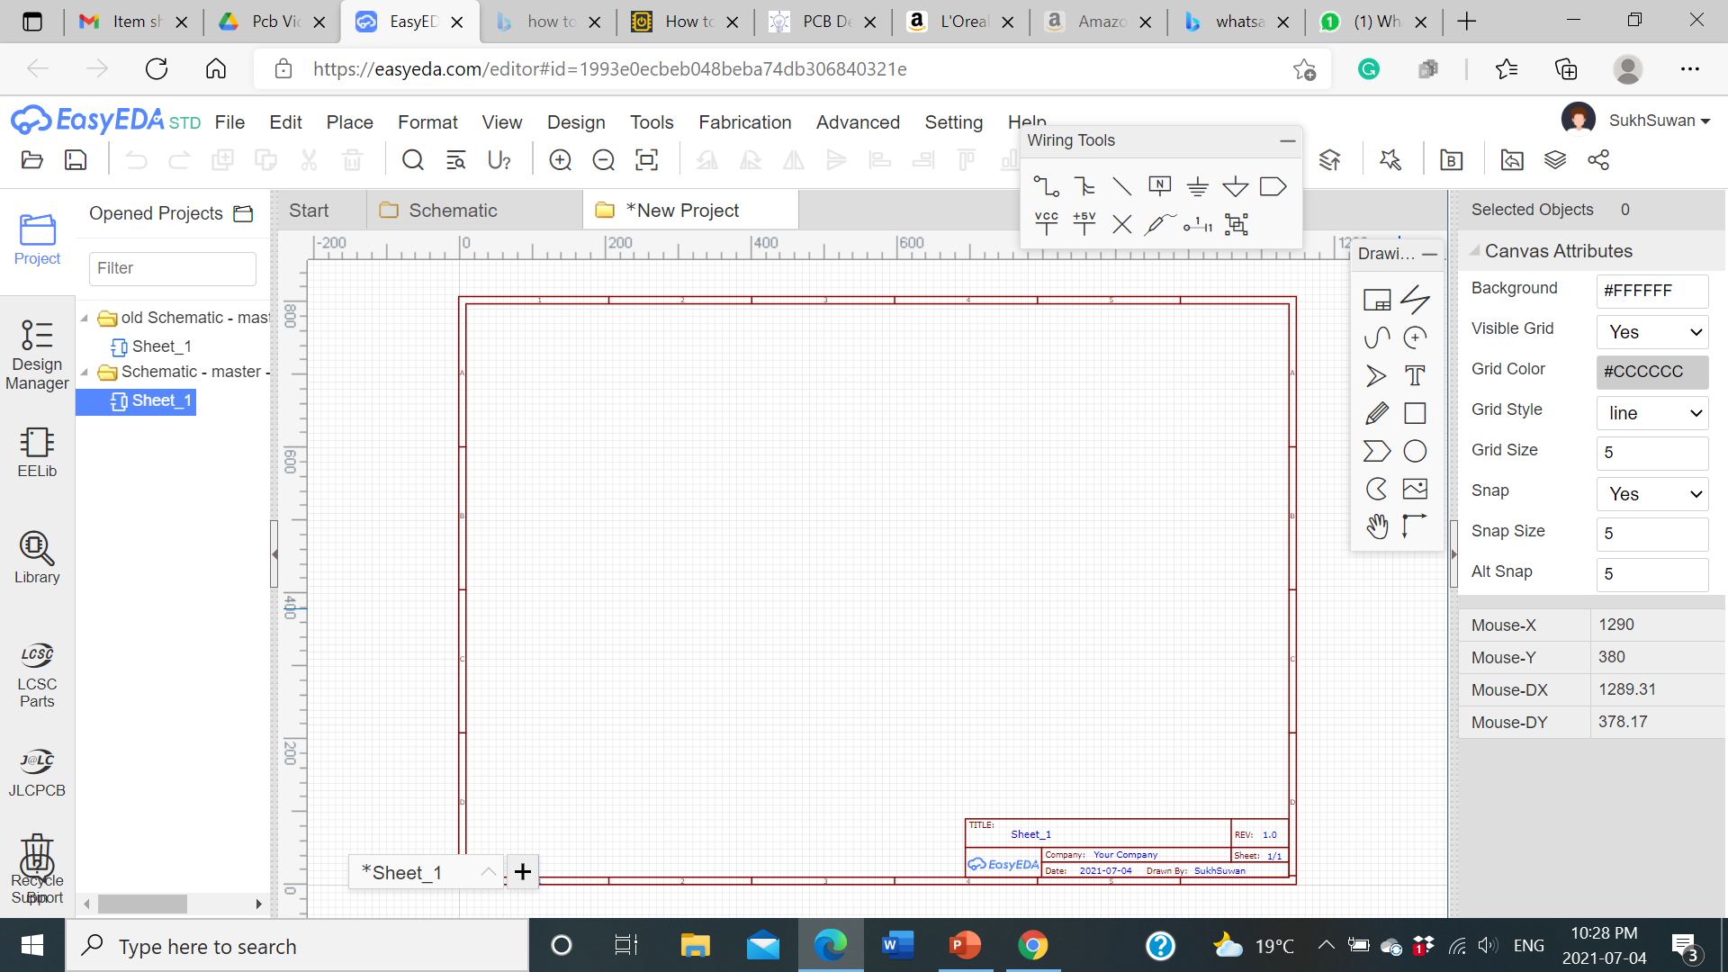
How to create a schematic
Go to File Menu , then click on New. There you can either create a project first then schematic or just click on schematic.
Then you’ll see a blank canvas where you can draw the schematic:

Slide 13
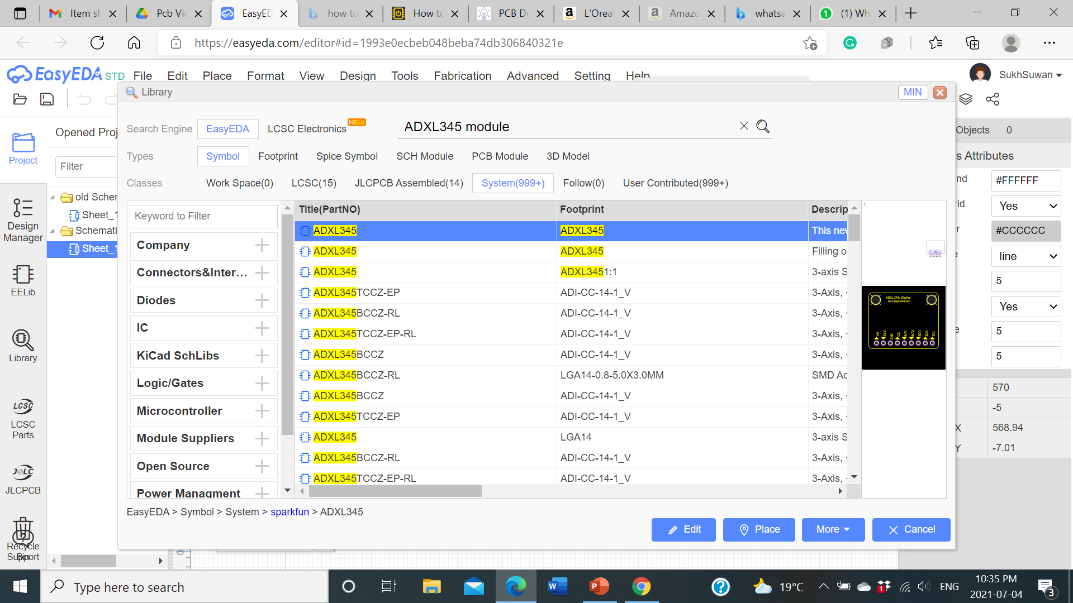
How to create a schematic
place all your schematic symbols on the canvas before drawing any wires.
schematic symbols are located in “Libraries”. The EELib has the common symbols.
there are also “User Generated Libraries” with lots of other symbols.

Slide 14
Points To remember
Make sure each schematic symbol we use needs to have a PCB footprint associated with it.
The PCB footprint will define the component’s physical dimensions and placement of the copper pads or through holes.
in the EasyEDA library, the schematic symbols already have footprints associated with them, but they can be changed if we’re using a different size or style.

Slide 15
Points to remember
To change the footprint associated with a schematic symbol, click on footprint on right side, search for the matched component in the “User Generated” libraries we’re using.
Once we find it. Select it and update it.

Slide 16
How to create a schematic
Start drawing the wires using the wiring tool on the top right corner.
Also label all the components, The labels will be transferred over to the PCB layout and eventually be printed on the finished PCB.
next step is to import the schematic into the PCB editor.

Slide 17
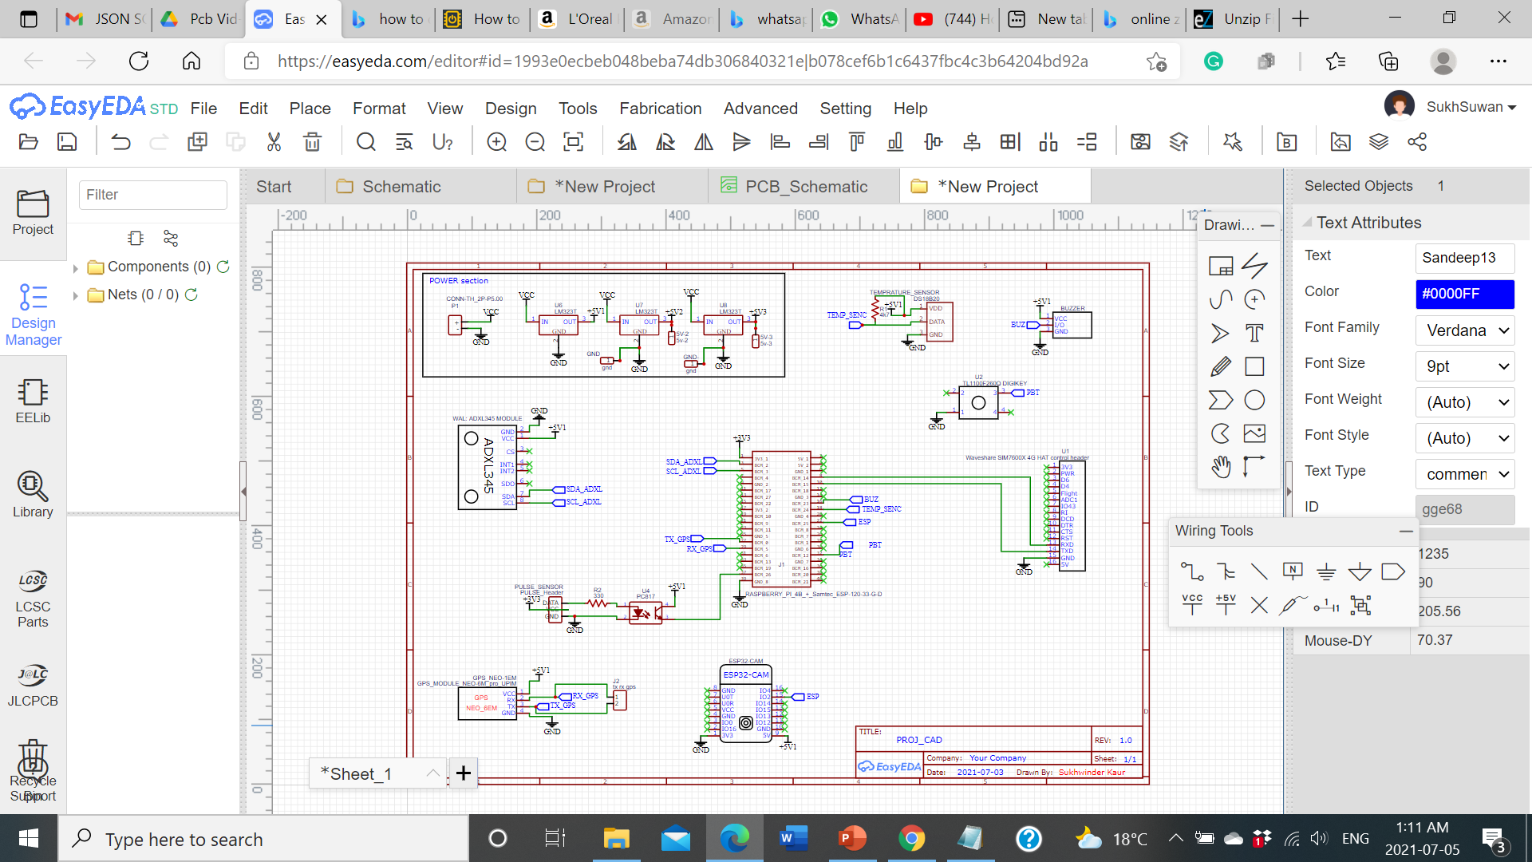
Schematic Diagram of Fall detection

Slide 18
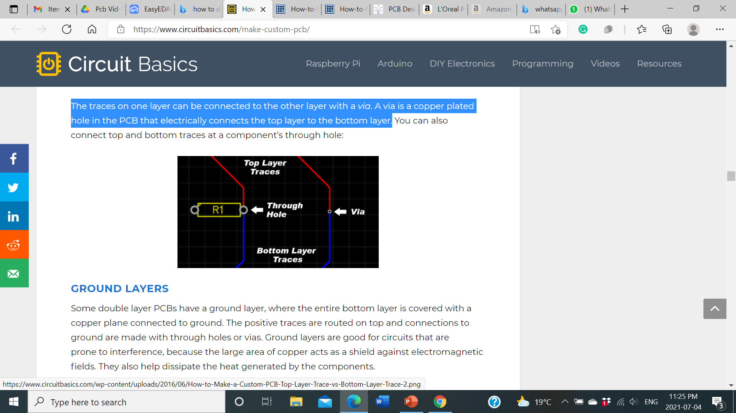
PCB Design layout
PCB DESIGN OPTIMIZATION: Identify what each part of your circuit does and divide the circuit into sections according to function.
Keep the components in each section grouped together in the same area of the PCB to keep the conductive traces short.
PCB LAYERS: Single Layer & Double layer:
Double layer: The traces on one layer can be connected to the other layer with a via. A via is a copper plated hole in the PCB that electrically connects the top layer to the bottom layer.
If there are multiple layers, then it relates to all layers.

Slide 19
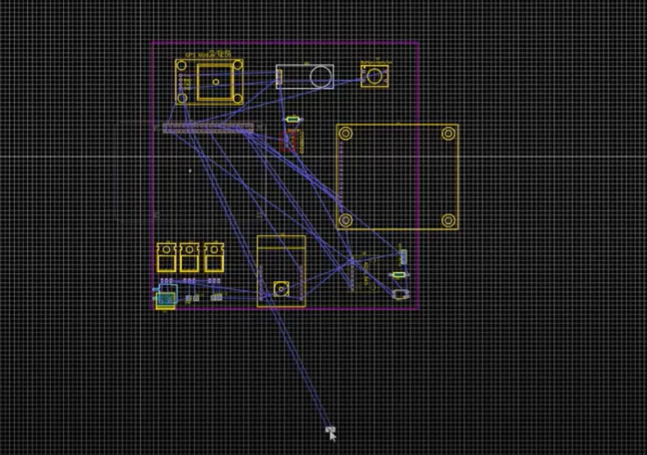
CREATING THE PCB LAYOUT
After creating the schematic click on the generate PCB icon.
The footprints associated with each schematic symbol will be automatically transferred to the PCB editor.
the thin blue lines connecting the components are called ratsnest lines.
Ratsnest lines are virtual wires that represent the connections between components. They show you where you need to route the traces according to the wiring connections you created in your schematic.

Slide 20
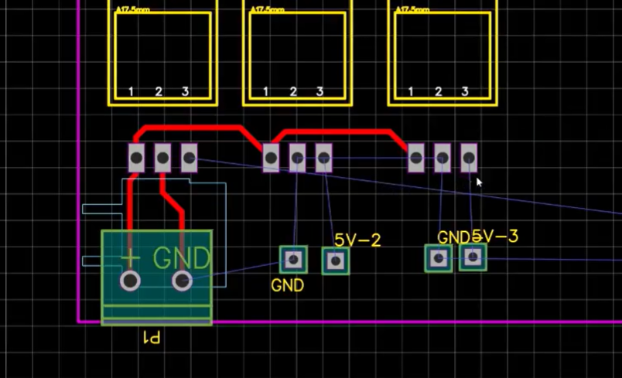
CREATING THE PCB LAYOUT
start arranging the components.
start drawing the traces. Use the ratsnest wires as a rough guide for routing each trace.
Traces can also be routed automatically using the software’s auto-router.

Slide 21
CREATING THE PCB LAYOUT
define the size and shape of the PCB outline. Click on the board outline and drag each side until all the components are inside.
run a design rule check (DRC).
A design rule check will tell you if any components overlap or if traces are routed too close together.
The design rule check can be found by clicking the “Design Manager” button in the left side window.

Slide 22
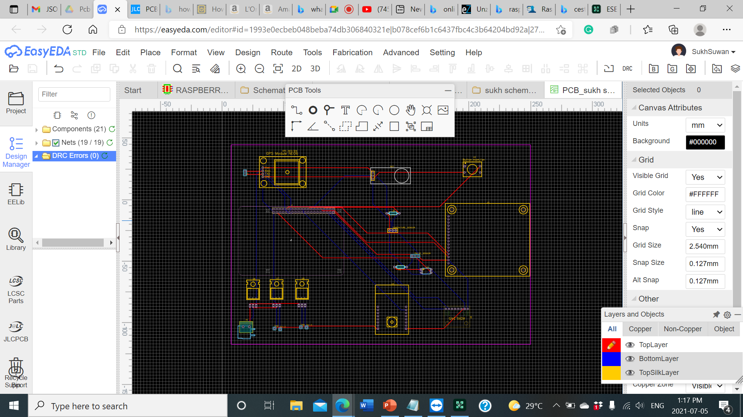
CREATING THE PCB LAYOUT
Items that fail the design rule check will be listed below the “DRC Errors” folder.
If you click on one of the errors, the problem trace or component will be highlighted in the PCB view

Slide 23
Finalisation of Pcb layout design
At last double check your PCB layout against your schematic to make sure that everything is connected properly.
If satisfied with the result, the next step is to order the PCB.
EasyEDA makes this part really easy.

Slide 24
ORDERING THE PCB
Start by clicking the “Fabrication Output” button in the top menu of the PCB editor
This will take you to another screen where you can choose the options for your PCB order
You can select the number of PCBs you want to order, the number of copper layers, the PCB thickness, copper weight, and even the PCB color. After you’ve made your selections, click “Save to Cart” and you’ll be taken to a page where you can enter your shipping address and billing information.

Slide 25
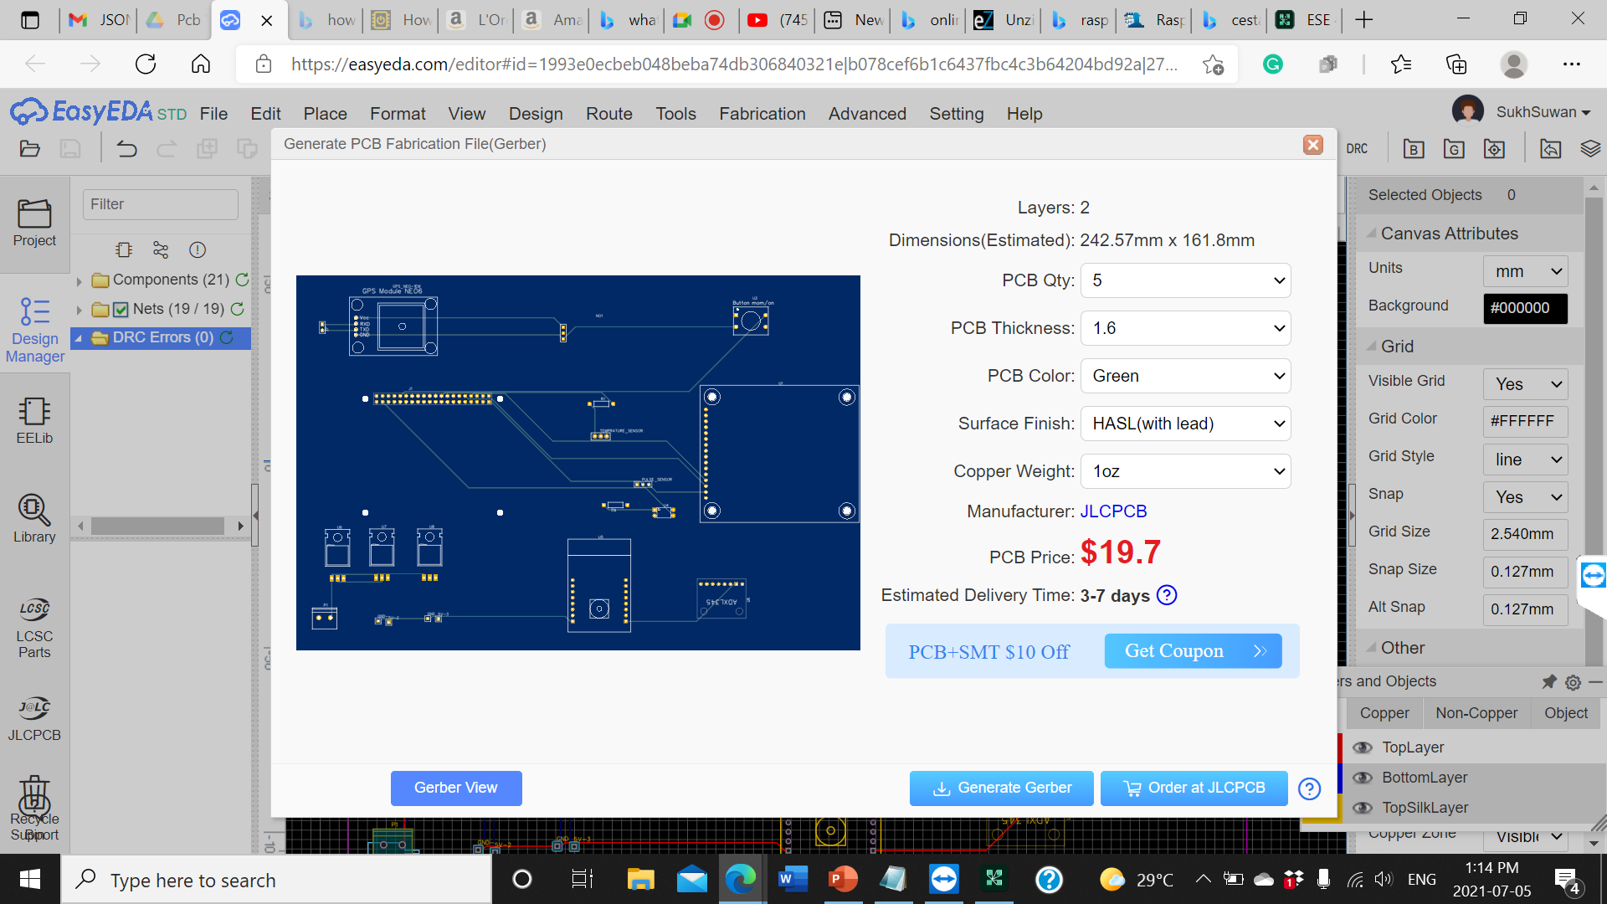
Gerber file
You can also download your PCB’s Gerber files if you want to send them to a different manufacturer.
Gerber files are a set of image files that contain the patterns used to manufacture your PCB.
All of the files are compressed into a single .zip file. There is a separate file for the copper traces, silk screen, and locations of drill holes and vias

Slide 26
REferences
Bell, K. (March 17, 2016). Brain shrinkage increases traumatic brain injury risk in older adults who fall, https://utswmed.org/medblog/tbi-older-adults/
Shmerling, R.(March 14, 2016).My Fall last Fall: Reaction time and getting older. https://www.health.harvard.edu/blog/my-fall-last-fall-201603149311
Techterms, what are PCB, https://techterms.com/definition/
Electronic Manufatcuring Services Group, (Top 10 Applications for PCBs). https://emsginc.com/resources/10-common-pcb-applications/

Slide 27
references
PCB DESIGN:
Scott Campbell (DIY Electronics), How to design a PCB, https://www.circuitbasics.com/make-custom-pcb/
Video link:
How to Design a PCB from Scratch with EasyEDA https://www.youtube.com/watch?v=q9fgMhfEzko

Slide 28

Thank you

